Slide 1


CompSci club
Data Types
Let’s build off what we learned last week with variables and print!

Slide 2
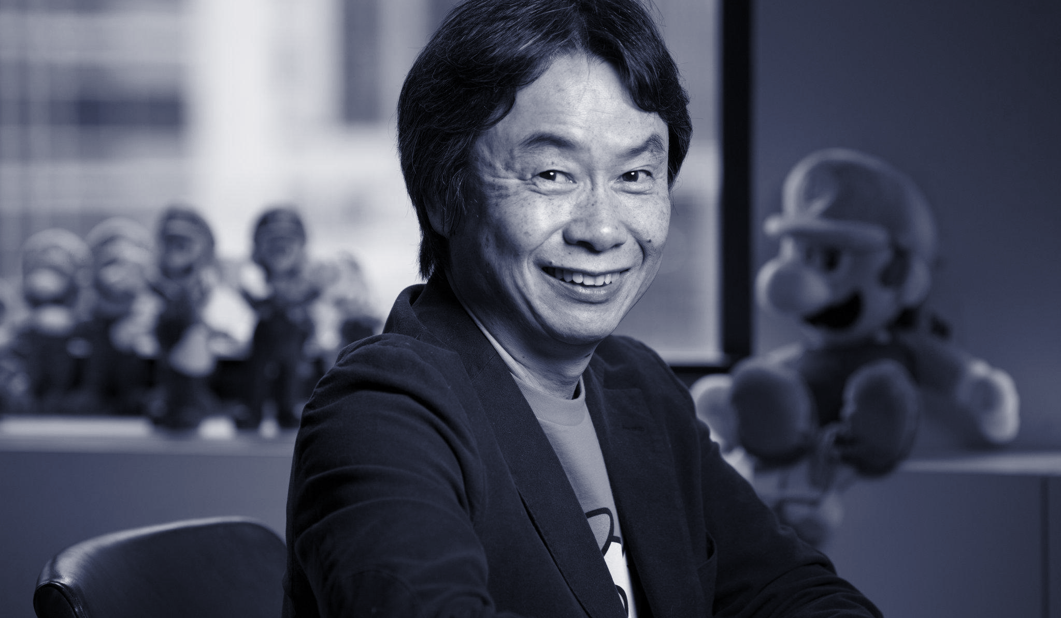
Our person of the day!
Shigeru Miyamoto
We all owe a part of our childhood to Shigeru Miyamoto, the creator of Super Mario, Donkey Kong, Zelda, Star Fox and more
On this day in 1985, Miyamoto and his colleague, Takashi Tezuka, released Super Mario Bros in Japan
This would be the first dedicated Mario game and the start of one of the greater video game franchises in history
It sold 1.2 million copies copies in September alone, and 58 million copies total
More than 310 million units of Mario have been sold worldwide and Super Mario 64, released in 1996, is considered one of the greatest games ever
Miyamoto is critical to Nintendo’s now $52.16 B stock evaluation, with Mario & Zelda alone worth $30.25 B
Japanese Game Designer

Slide 3



Roadmap for Today
An overview of all Python data types
There is quite a few data types. Luckily, we have a nifty chart to help you out
Delving into the most important data types
Let’s cover the data types we will use the most
Practice
Some simple, hopefully routine, practice about data types!
Notes:
Ask what Github is and what version control is

Slide 4
Don’t worry! We won’t use all of them frequently
An overview of
Python Data types

Slide 5
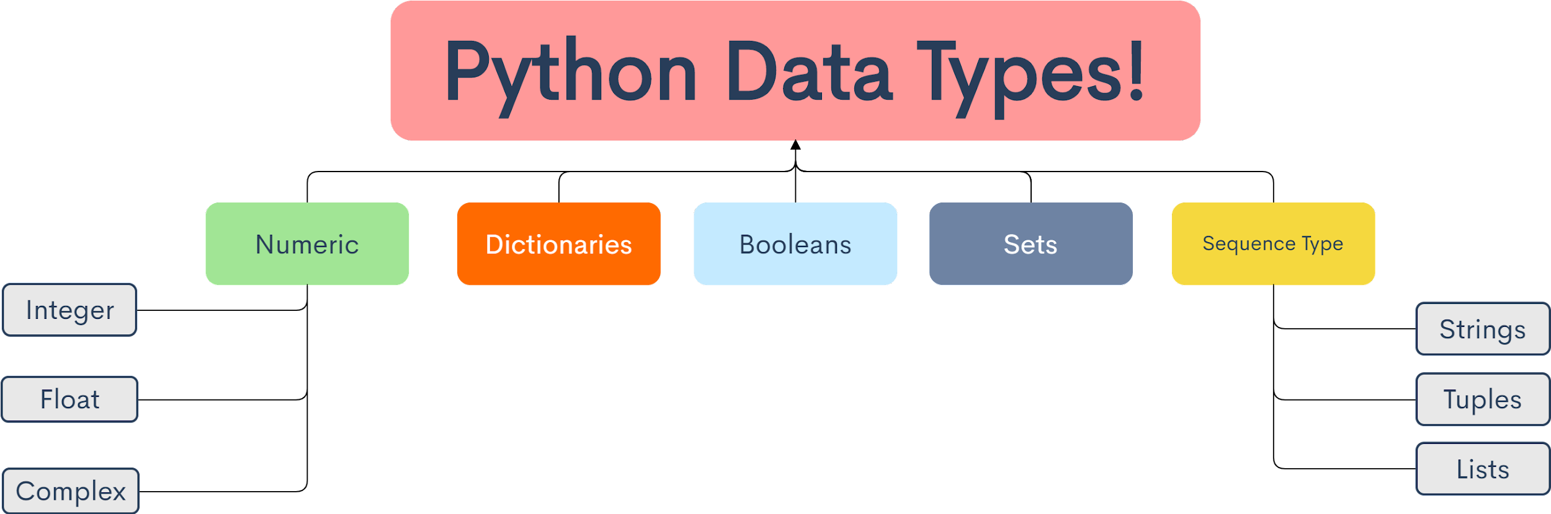
Here are all of the data types in Python! Some of them we use all the time (strings, integers, lists), and others we almost never use in this club (sequences, complex)

Slide 6
The ones you should know really well!
A deep dive into
Important Python Data types

Slide 7
Numeric Data Types
If you have never worked with programming languages before (or even if you have!) you might be puzzled why we have these things called data types
That is because different types of data take up different amounts of memory in our computer
If we just had “one-size fits all” data type, it would have to have enough memory for all types of numbers, and all types of words
In Python, we have 3 types of numeric data types
Integer
3, 7, 11, 20432423, 29
Float
2.0, 1.0, 43.23256, 3.14159265359
Complex
2 + 4j, 2423 + 423j
We will use Integer and Float quite often, but for our purposes, we will really never use complex
#Integers
print(1 + 2)
#Float
print(1.0 + 2.0)
#Complex
print(3 + 14j)
Notes:
For Complex Numbers, you have to use j to indicate an imaginary number (instead of the usual i) we see in math class
If you want to learn more about that, check out this great Stackoverflow Post! https://stackoverflow.com/a/24812657

Slide 8
Booleans
in_quarantine = True
can_go_outside = False
If you have worked with programming languages in the past, this concept may be very familiar!
Booleans are simply the keywords ‘True’ and ‘False’ in Python
It is important that these words when you type them are capitalized, if not, you will get an error in your code because Python doesn’t know what you are referring to!
Booleans also include the various comparison operators Python includes
== (Equal To)
Make note of the double equals, remember, one equals is used for variables!
!= (Not Equal To)
< (Less Than)
> (Greater Than)
<= (Less than or equal to)
>= (Greater than or equal to)
numx = 7
numy = 11
print(numx < numy) #True
print(numx == numy) #False
print(numx != numy) #True
print(numx >= numy) #False
Notes:
For Complex Numbers, you have to use j to indicate an imaginary number (instead of the usual i) we see in math class
If you want to learn more about that, check out this great Stackoverflow Post! https://stackoverflow.com/a/24812657

Slide 9
strings
birthday = "October 5th"
Probably one of the most used data types in all of coding - strings are a fundamental part of any, any language you will ever use!
From Python to C++, you will use strings
Single and Double quotes do the same exact thing, but if you start with a single quote, you must end with a double quote and vice versa
Strings are made up of Unicode characters:
These Unicode characters relate back to Binary, which we won’t go over here (many of you might be very familiar with it already!)
Like you will see with dictionaries in just a few slides, you can splice strings
This allows us to grab specific characters from a string and use it for something else
Indexing starts at 0, not one, this is super important for all program languages
alphabet = "abcdefghijk"
letter_a = alphabet[0]
letter_unknown = alphabet[4]
letters_splice = alphabet[0:4]
print(letter_a) #a
print(letter_unknown)
print(letters_splice)
#What would the last two lines of the code above print?
Notes:
For Complex Numbers, you have to use j to indicate an imaginary number (instead of the usual i) we see in math class
If you want to learn more about that, check out this great Stackoverflow Post! https://stackoverflow.com/a/24812657

Slide 10
Lists
integer_list = [1,2,3,4,5]
Lists are one of the most useful aspects of Python, and like other data types, they are unique to Python!
Lists are denoted with brackets [ ], and they can have any data you want in them (strings, numbers, floats, etc…)
Each object in a list is separated by a comma (think about lists of objects in English, same idea!)
We can even have lists inside of lists
When we want to grab something from a list (the term which is used is called “unpacking”), we can use list indexing
Put the name of the variable which your list is stored in and then the number which your object is located
NOTE! For all languages (not just Python) counting starts at 0, not 1! (so for favorite_colors on the right, the object at index 0 would be red)
favorite_colors = ["red","green","blue"]
random_list = [11,"water",212.432]
print(integer_list[0])
print(integer_list[4])
Notes:
For Complex Numbers, you have to use j to indicate an imaginary number (instead of the usual i) we see in math class
If you want to learn more about that, check out this great Stackoverflow Post! https://stackoverflow.com/a/24812657

Slide 11
Hopefully it will be really low-stress!
Practice with
Our data Types

Slide 12
List practice
You are going to be presented with a list. Try to access certain parts of that list by using the index of the list.
normal_list = [1,"hello", 4.375, 'look!',[2,5,789,'another list!'],{"key":"value"}]
Please access the list, and print out the following things from the list:
Print out “hello”
Print out the third object in the list
Print out the list object that is in the list ([2,5,789,'another list!'])
Challenge: Print out “789” in the imbedded list
Challenge: Print out the dictionary without writing normal_list[5]

Slide 13
String practice
You are going to be presented with variables. Please work with those variables to do a couple things:
Print out the type of all of the variables mentioned
Can you make more variables of each of those types?
Make at least 4 new variables and be ready to share them
Finally do some math with those variables!
Do at least 2 operations with those variables
adding the string with an integer or a float!
Make another variable that has string as its’ type and try to add those 2 strings together, what happens?
var_one = "hello"
var_two = 3.575695
x = 4
y = 4.0
z = 3 + 4j

Slide 14
List practice
my_var = "I am so annoying"
print(my_var[0:4] + " " +
my_var[9] + my_var[11] + my_var[13] + my_var[5]+ my_var[12])
#I am noisy
As we mentioned, strings are so useful in programming languages and we will use them all the time
We introduced you to string splicing earlier, so now it is time to practice!
Your Task:
You are going to use string slicing to take the following words out of the following longer words:
Take out ‘star’ out of ‘startle’
Take out ‘trump’ out of ‘trumped’
Take ‘ace’ out of ‘bracelet’
Take out ‘one’ from ‘money’
Challenges:
Take out ‘inch’ from ‘China’
Rearrange ‘WORDS’ to ‘SWORD’
TIP: For these, instead of doing every individual letter
you can use [#:#] to take out chunks of words (look at example on the left)
attic = "attic"
print(attic[4] + attic[0] + attic[2])
#Cat
corner = "corner"
print(corner[0:4])
#Corn

